Slide 1
ChessBaxter
Lorenzo Betto

Slide 2
Was the goal of the project clear from the video?
Detect the state of the chessboard and output the next move
How to do that?

Slide 3
Was the goal of the project clear from the video?
Detect the state of the chessboard and output the next move
How to do that?
Detect the chessboard in an image
Detect the pieces that sit on it
Pass the state of the chessboard to a chess engine for the next move

Slide 4
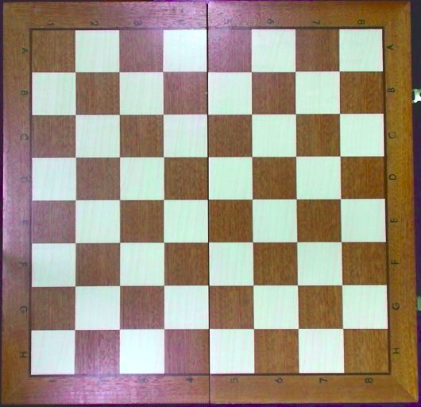
1- Detect the chessboard in an image
Feature matching (SIFT)

Slide 5
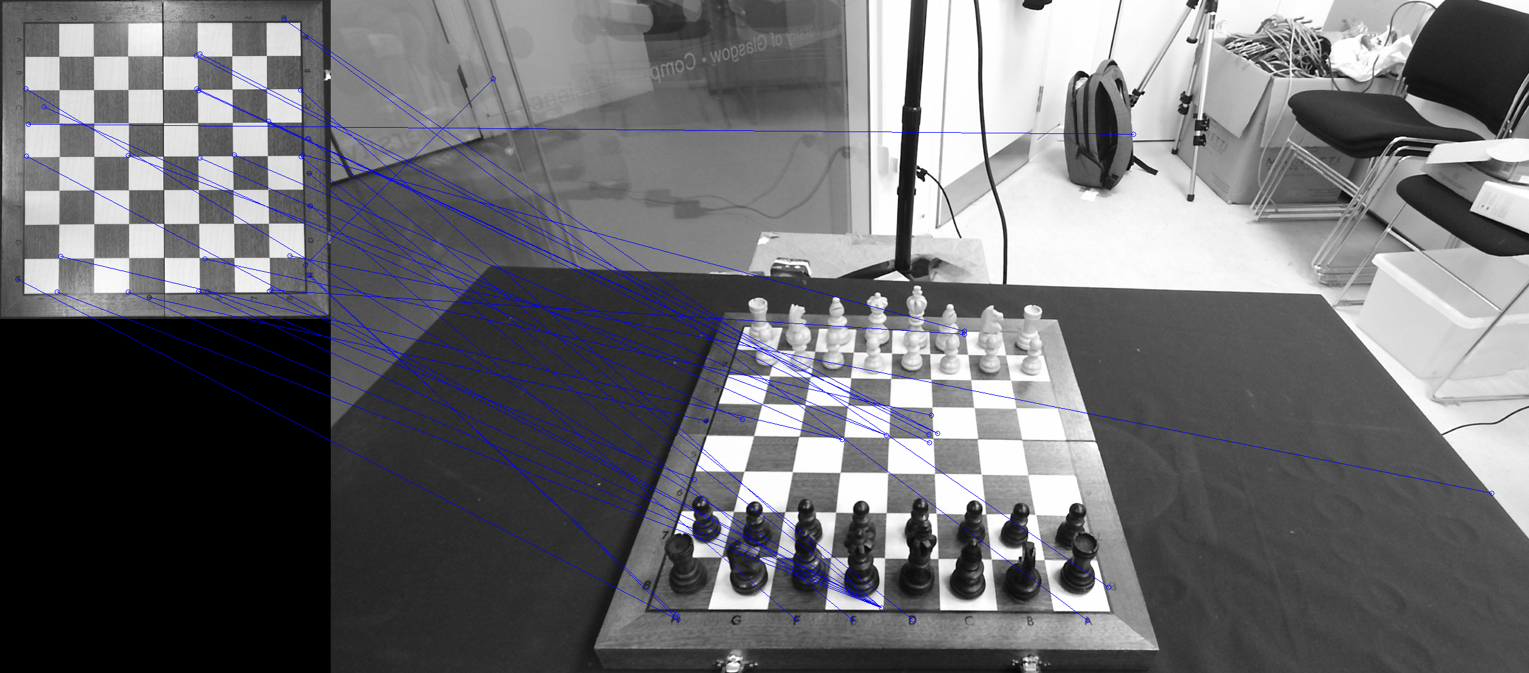
1- Detect the chessboard in an image
Feature matching (SIFT)

Slide 6
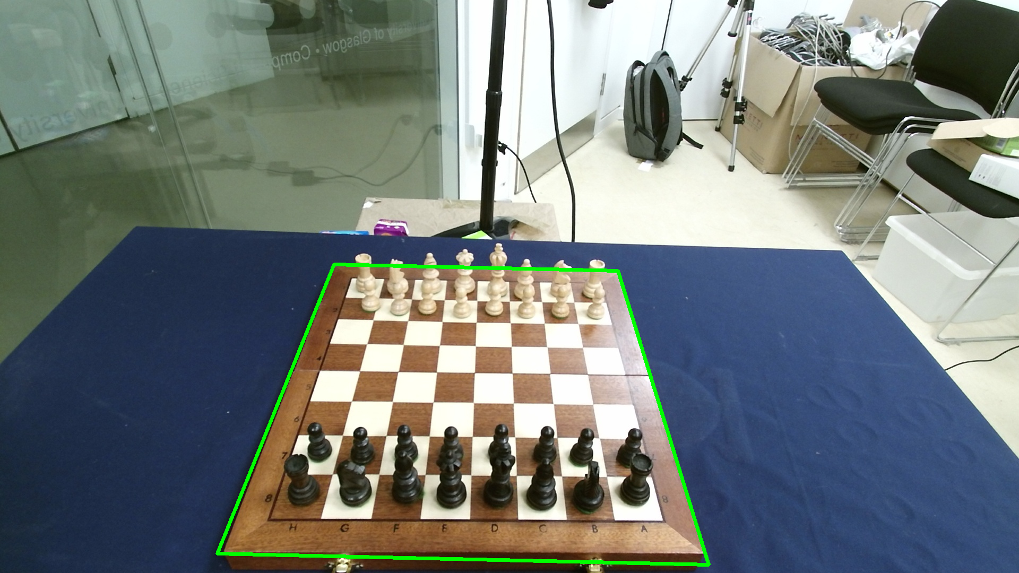
1- Detect the chessboard in an image
Homography
Notes:
At this point I would make

Slide 7
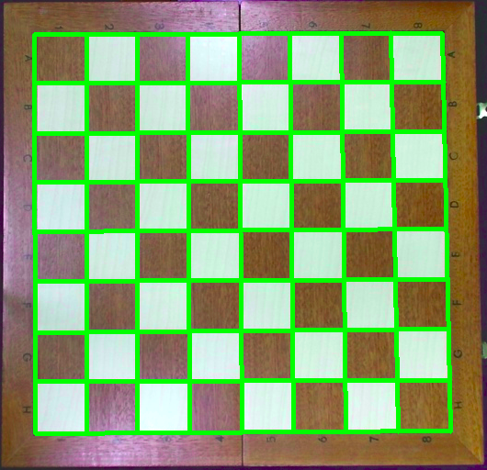
1- Detect the chessboard in an image
Segmentation

Slide 8
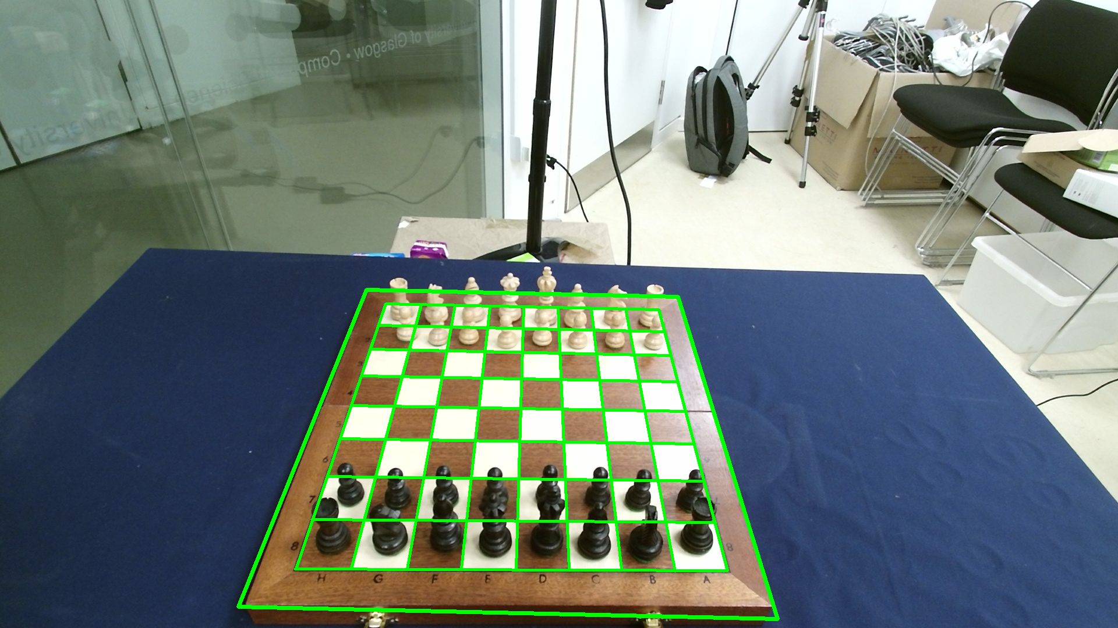
1- Detect the chessboard in an image
Segmentation

Slide 9
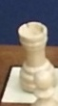
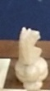
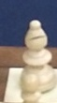
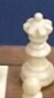
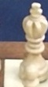
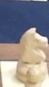
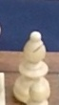
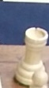
2- Detect the state of the chessboard
Sliding window

Slide 10
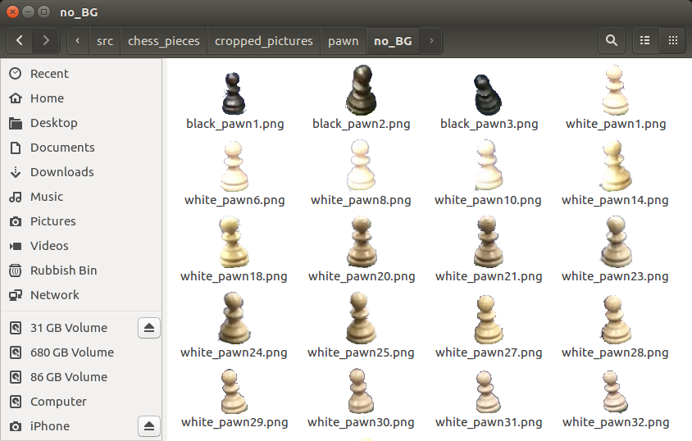
2- Detect the state of the chessboard
Piece classification
Training data:
Total = 260 samples for now
(later 1070 in the whole training set)
Notes:
To perform classification one needs to have a classifier, which is an algorithm that is capable of distinguishing different objects. Classifiers need training data in order to generalise among the different classes we are trying to classify. The training data contains samples of each class and this folder for example contains samples of pawns.

Slide 11
2- Detect the state of the chessboard
Piece classification
Features
SIFT
ORB
HOG
Classifiers
Support Vector Machine
Logistic Regression
K-Nearest Neighbours
… And many others ...

Slide 12
2- Detect the state of the chessboard
Everything was going pretty bad until...

Slide 13
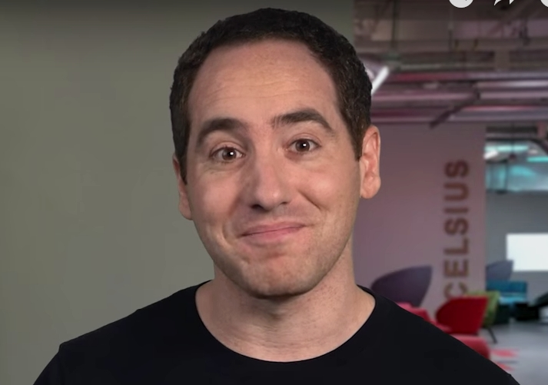
Notes:
[...until…] Until I found this guy!

Slide 14

2- Detect the state of the chessboard
Notes:
His name is Josh Gordon and he is part of the Google Developers team. In this video tutorials he explains how to use Deep Learning and a pre-trained classifier for image classification.

Slide 15
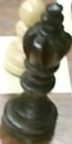
2- Detect the state of the chessboard
Finally good results!
Prediction
king (score = 0.72568)
pawn (score = 0.16083)
queen (score = 0.08605)
bishop (score = 0.02181)
rook (score = 0.00539)
knight (score = 0.00024)

Slide 16
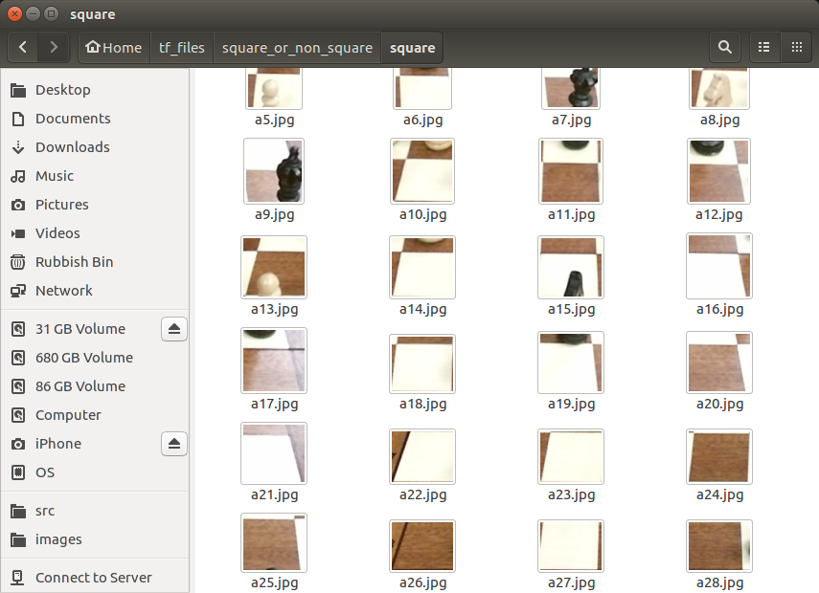
2- Detect the state of the chessboard
What now?
-> Empty square classifier
Colour classifier
Classify each square and
convert to FEN notation
Notes:
Training data for the empty squares

Slide 17
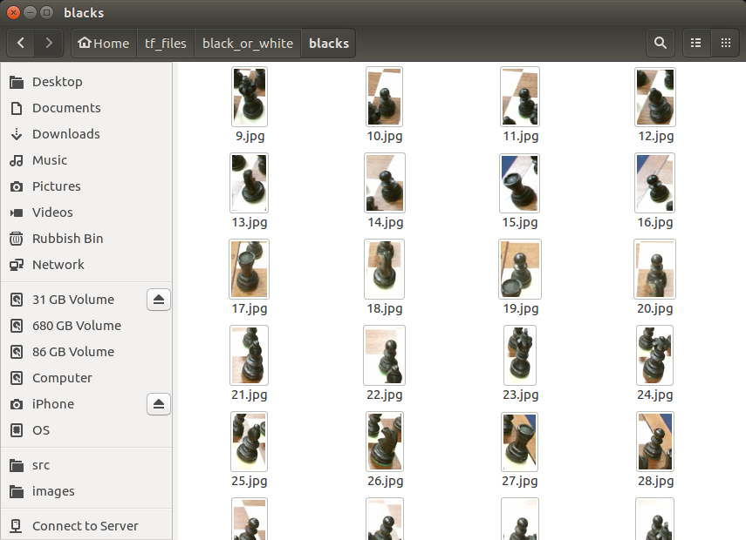
2- Detect the state of the chessboard
What now?
Empty square classifier
-> Colour classifier
Classify each square and
convert to FEN notation
Notes:
Training data for the black pieces

Slide 18
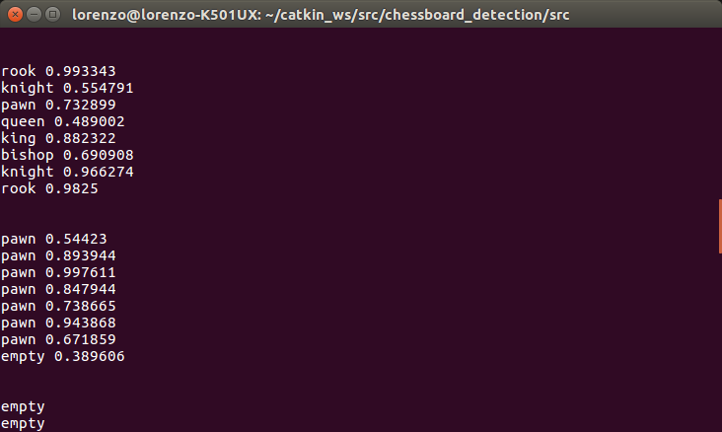
2- Detect the state of the chessboard
What now?
Empty square classifier
Colour classifier
-> Classify each square and
convert to FEN notation
rnbqkbnr/pppppppp/8/8/8/8/PPPPPPPP/RNBQKBNR w KQkq - 0 0

Slide 19
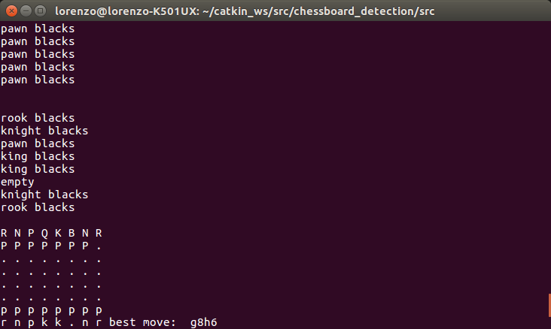
3- Output the next move
Finally, pass the state of the chessboard to the chess engine and output the next move

Slide 20
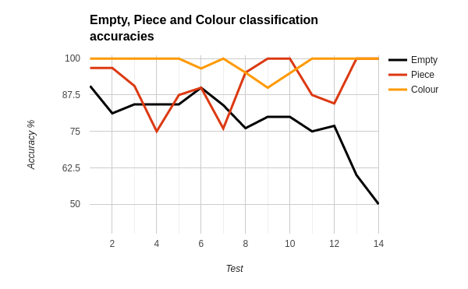
Evaluation
Empty | 78.33
Piece | 91.42
Colour | 98.34
Notes:
Now, as you probably saw from the previous screenshot the detection wasn’t perfect.
These are the accuracies of the three classifiers over 14 tests and as you can see the piece classifier works fairly well, the colour classifier works almost perfectly and the empty square can still be improved.

Slide 21
Thank you
Any questions?

